Slide 1
University of Napoli Federico II - Bauman MSTU MoU startup meeting (Some elements of inspiration) On Electromagnetic Fields at Engineering
The Electromagnetic Fields research group
Daniele Riccio (speaker)
October 20, 2021

Slide 2
Leading roles in teaching and research
(held by members of the EM research group)
Cassini Radar Science Team (NASA)
COSMO/Skymed, Platino (ASI)
Coordination of PhD, M.Sc and B.Sc. programmes in the Engineering area at the University of Napoli Federico II.
General Chair of the 5G International PhD School (2018-2021)
PhD School – 5G Italy 2020
PhD School – 5G Italy 2021
PhD Board on Space at the Scuola Superiore Meridionale.
Advisories/actors in international research programs on Space

Slide 3
Applied electromagnetics:
Antennas, measurements, and components
Antenna diagnosis and synthesis
Measurements
Analysis and synthesis of microwave components
Diagnosis of array and reflector antennas, reflector antenna synthesis, array antenna synthesis, even phase only, even including near-field constraints and aperiodic lattices with constraints on spacing and encumbrance, sub-array partitioning, reflectarray antenna synthesis, non-invasive dielectric field sensors.
Amplitude and phase and phaseless Near-Field/Far-Field transformations, optimized sampling techniques, non-invasive probes, synthesis of plane wave synthesizer, synthesis of echo generators, reconstruction of incoherent sources, advanced millimeter-wave measurements.
Analysis and synthesis of filters, beamforming networks, true-time delay architectures.

Slide 4
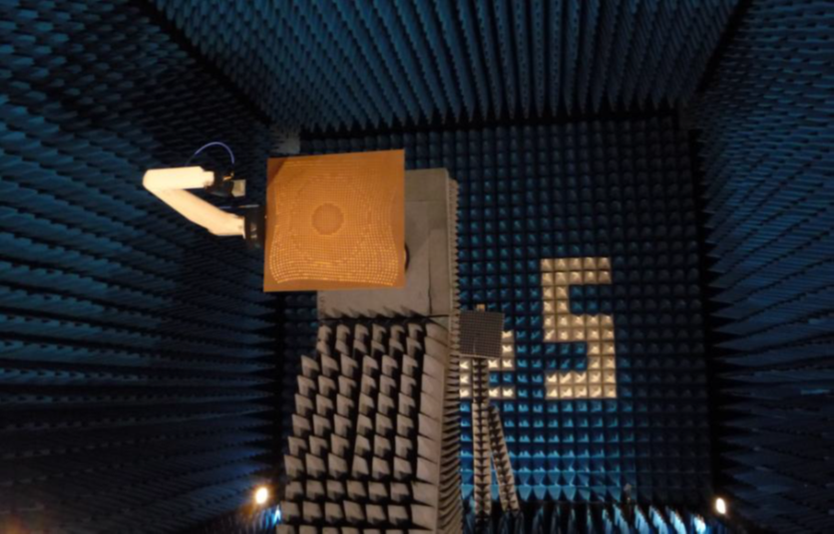
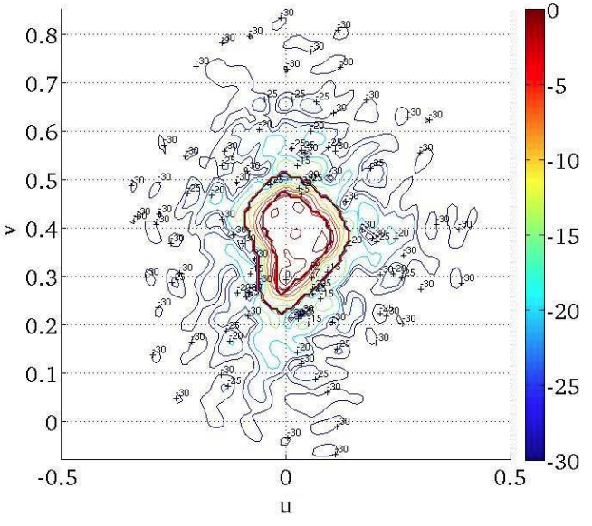
Periodic and aperiodic reflectarrays for satellite applications for which a shaped beam pattern in required
Aperiodic reflectarray
Example of shaped beam pattern with South America coverage

Slide 5
Applied electromagnetics:
Computational, Inverse problems and optimization
Computational electromagnetics
Inverse problems
Optimization techniques
Fast numerical methods for direct scattering, fast marching for asymptotic solutions, ultra-fast Radar Cross Section prediction, modeling of plasma-motion in electric thrusters and fast numerical implementation, Graphics Processing Units acceleration for computational electromagnetics, supercomputing on hybrid hardware, fast processing for Magnetic Resonance Imaging, optimized computational schemes for Non-Uniform FFT (NUFFT), data structures for the numerical acceleration of ray tracing algorithms, Boundary Volume Hierarchy, KD-Tree, efficient parallel numerical schemes for the evaluation of singular values.
Microwave tomography, sampling techniques, holographic tomography, extraction of synthetic parameters in inverse scattering, Singular Value Optimization.
multi-step/multi-stage optimization approaches with GPU acceleration.

Slide 6
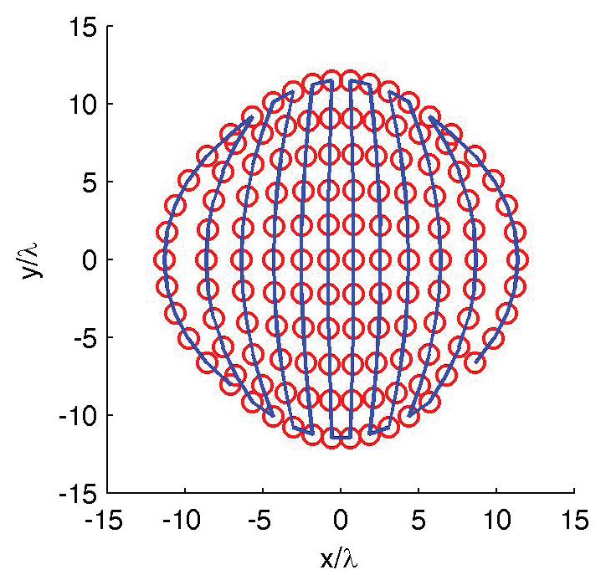
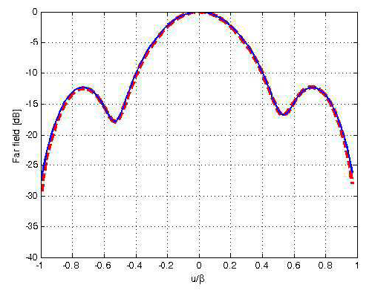
Singular Value Optimization (SVO) approach for near-field antenna characterization
Example of antenna near-field sampling with the SVO approach
Example of experimental antenna far-field reconstruction with the SVO approach

Slide 7
Scattering and Propagation
Method
Electromagnetic scattering from natural surfaces
Diffraction from smooth and rough edges
Electromagnetic wave propagation in urban areas [6-7] and indoor environments
The activity of the research group is aimed at developing a strong theoretical background on electromagnetic propagation and scattering, that is then employed in both well-established and emerging applications.
modeled by using concepts of fractal geometry [0-3];
via asymptotic techniques [4-5];

Slide 8
Books
(examples)

Slide 9
Microwave remote sensing
Synthetic Aperture Radars
Bistatic radar remote sensing
SAR remote sensing
of infrastructures and urban areas [P3-P4]
Terrain displacement maps obtained via Differential SAR Interferometry.
by using transmitters of opportunity: GNSS-R, Formation-Flying SAR [P2];
maritime surveillance
for hydrology and agriculture [2, 9];

Slide 10
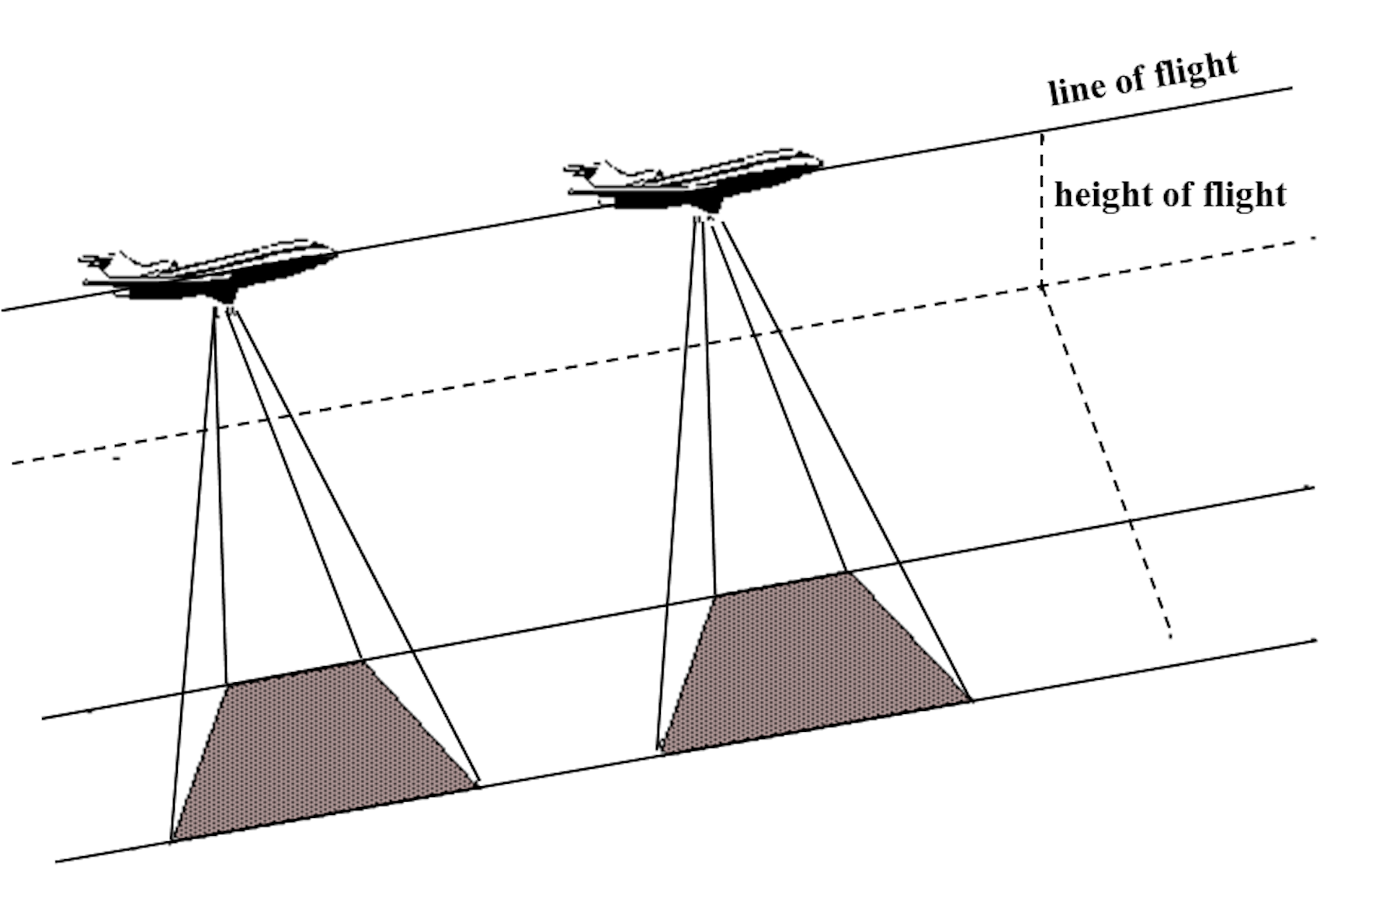
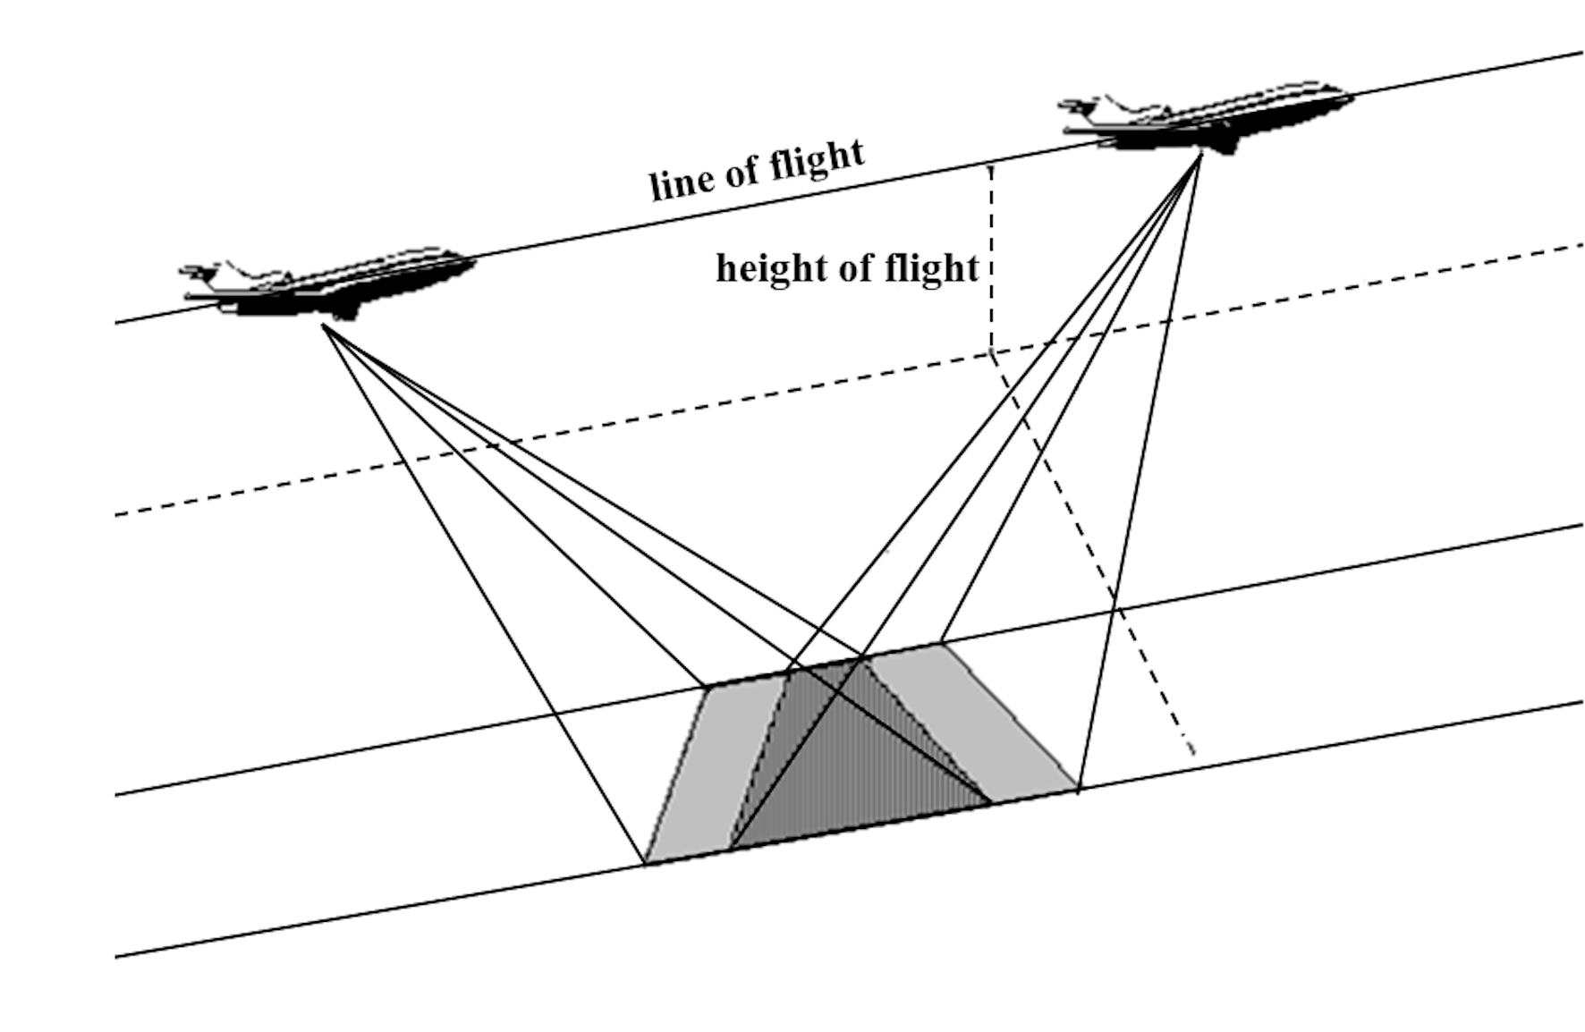
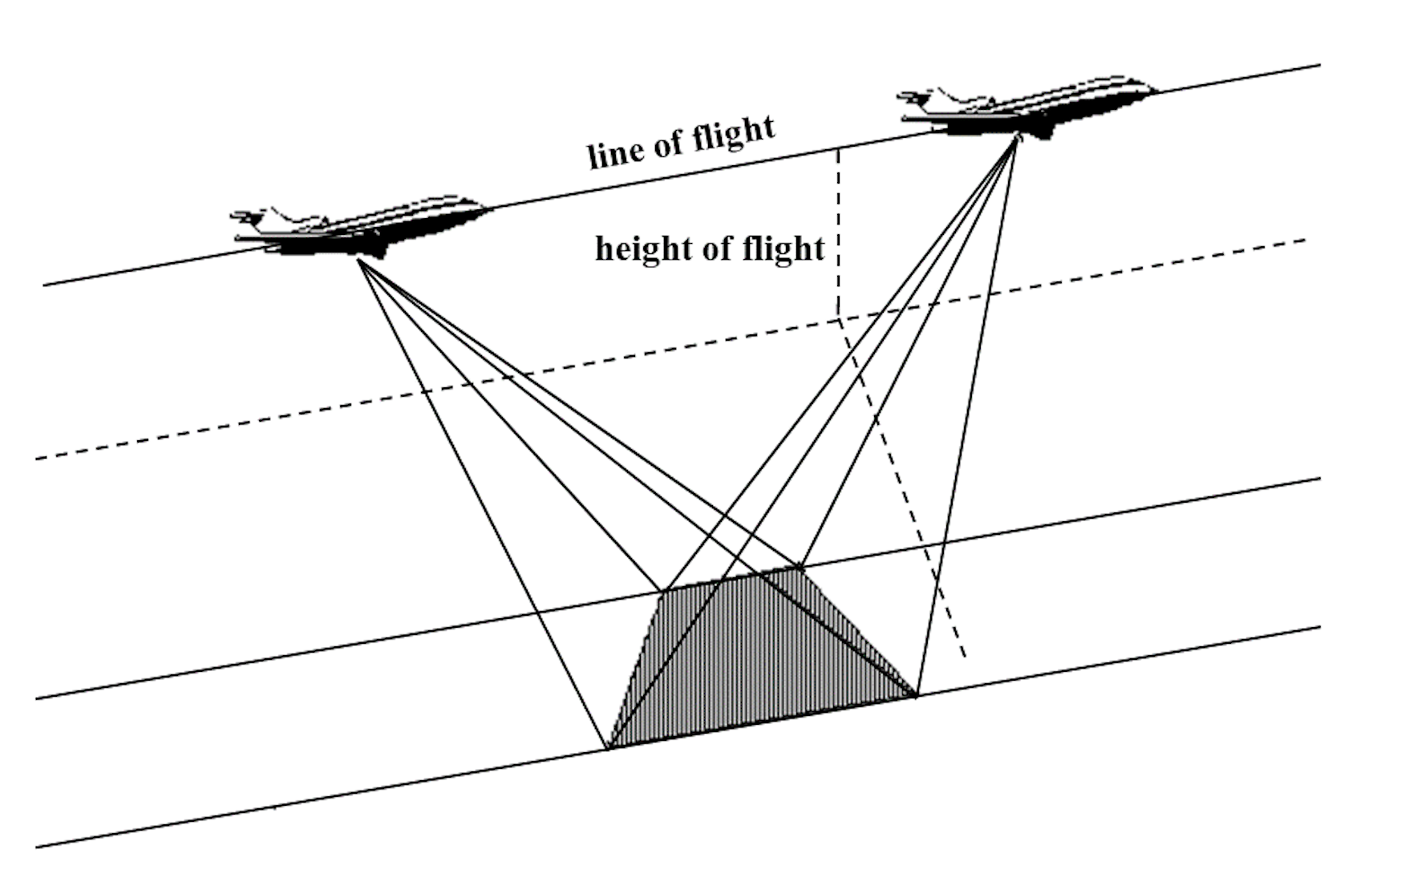
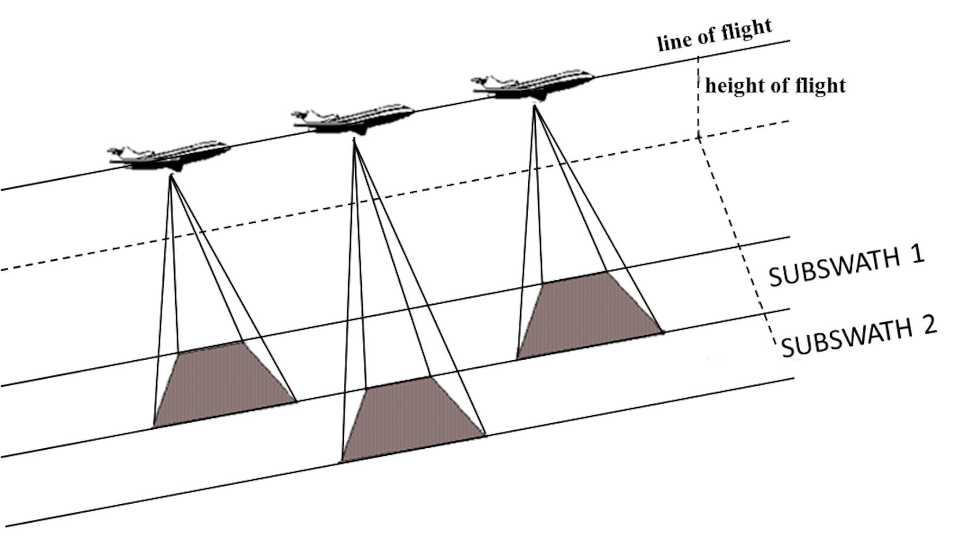
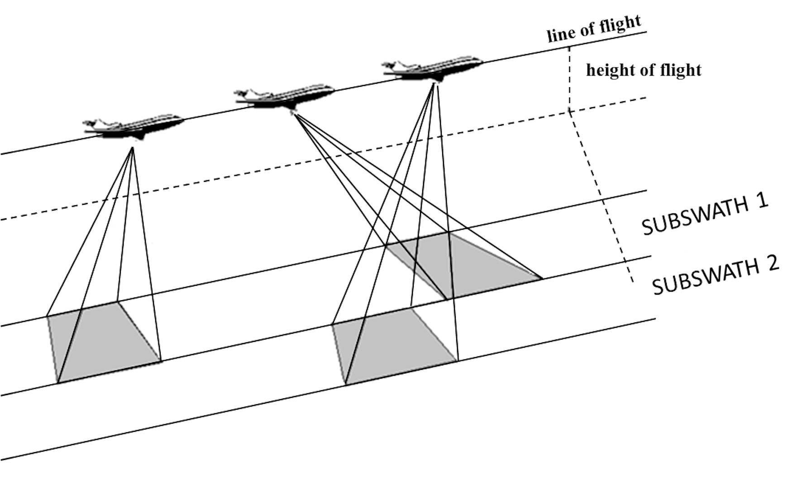
Stripmap
Sliding spotlight
Spotlight
ScanSAR
TopSAR

Slide 11
Wireless networks
of any generation
Wi-Fi access point positioning in large buildings,
Wireless sensor network planning [P5]
Base station location, antenna parameters setting, field intensity levels and delays; with past cooperation with access point installers;
Quality of the signal assessment, delay spread and multipath;
Mobile phone network planning [6],
Cell allocation strategy, continuity of the services

Slide 12
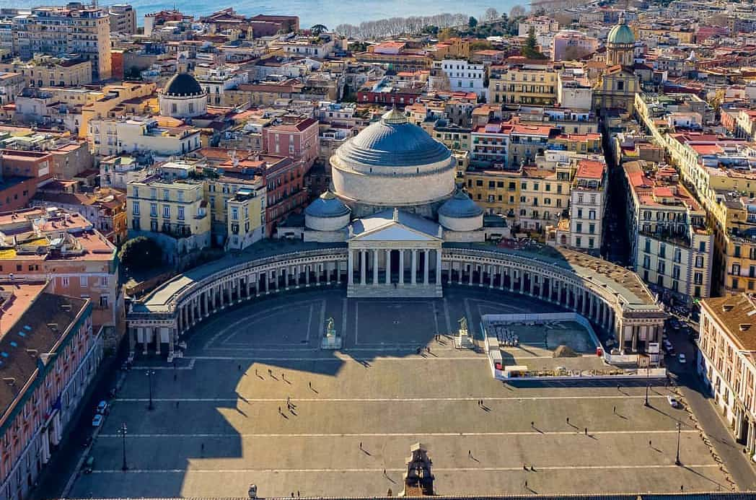
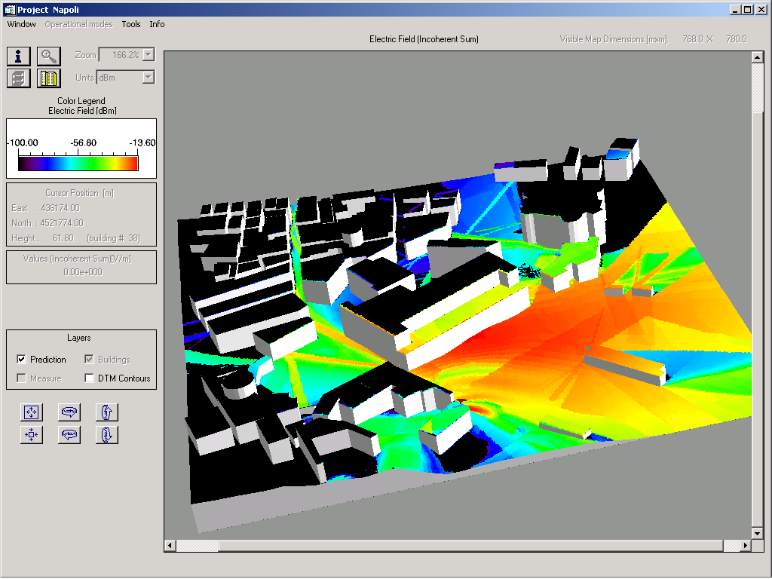
Walking user

Slide 13
List of selected publications Applied electromagnetics
[1] Gallo G, Isoldi A, Del Gatto D, Savino R, Capozzoli A, Curcio C, Liseno A. Numerical Aspects of Particle-in-Cell Simulations for Plasma-Motion Modeling of Electric Thrusters. Aerospace. 2021; 8(5):138. https://doi.org/10.3390/aerospace8050138
[2] D. Pirone, P. Memmolo, F. Merola, L. Miccio, M. Mugnano, A. Capozzoli, C. Curcio, A. Liseno, and P. Ferraro, "Rolling angle recovery of flowing cells in holographic tomography exploiting the phase similarity," Appl. Opt. 60, A277-A284 (2021).
[3] Capozzoli A, Curcio C, Liseno A. On the Optimal Field Sensing in Near-Field Characterization. Sensors. 2021; 21(13):4460. https://doi.org/10.3390/s21134460
[4] A. Capozzoli, C. Curcio and A. Liseno, "Optimized Nonuniform FFTs and Their Application to Array Factor Computation," in IEEE Transactions on Antennas and Propagation, vol. 67, no. 6, pp. 3924-3938, June 2019, doi: 10.1109/TAP.2018.2826368.
[5] Capozzoli, A., Curcio, C., & Liseno, A. (2020). CUDA-Based Particle Swarm Optimization in Reflectarray Antenna Synthesis. Advanced Electromagnetics, 9(2), 66–74. https://doi.org/10.7716/aem.v9i2.1389
[6] A. Breglia, A. Capozzoli, C. Curcio and A. Liseno, "Comparison of Acceleration Data Structures for Electromagnetic Ray-Tracing Purposes on GPUs [EM Programmer's Notebook]," in IEEE Antennas and Propagation Magazine, vol. 57, no. 5, pp. 159-176, Oct. 2015, doi: 10.1109/MAP.2015.2470685.
[7] Amedeo Capozzoli, Claudio Curcio, and Angelo Liseno, "Experimental Field Reconstruction of Incoherent Sources," Progress In Electromagnetics Research B, Vol. 47, 219-239, 2013.
[8] A. Capozzoli, C. Curcio and A. Liseno, "Time-Harmonic Echo Generation," in IEEE Transactions on Antennas and Propagation, vol. 59, no. 9, pp. 3234-3245, Sept. 2011, doi: 10.1109/TAP.2011.2161548.
[9] A. Capozzoli et al., "Photonic Probes and Advanced (Also Phaseless) Near-Field Far-Field Techniques," in IEEE Antennas and Propagation Magazine, vol. 52, no. 5, pp. 232-241, Oct. 2010, doi: 10.1109/MAP.2010.5687550.
[10] A. Capozzoli, C. Curcio, G. D'Elia and A. Liseno, "Phaseless Antenna Characterization by Effective Aperture Field and Data Representations," in IEEE Transactions on Antennas and Propagation, vol. 57, no. 1, pp. 215-230, Jan. 2009, doi: 10.1109/TAP.2008.2009647.
[11] A. Capozzoli, C. Curcio and A. Liseno, "Singular Value Optimization in Inverse Electromagnetic Scattering," in IEEE Antennas and Wireless Propagation Letters, vol. 16, pp. 1094-1097, 2017, doi: 10.1109/LAWP.2016.2622713.

Slide 14
List of selected publications Remote sensing
[0] G.Franceschetti, D.Riccio, "Scattering, Natural Surfaces and Fractals", Academic Press, Burlington, MA (USA), ISBN 13:978-0-12-265655-2, pp.304, gen.2007.
[1] G. Di Martino, A. Iodice, D. Riccio, “Closed-Form Anisotropic Polarimetric Two-Scale Model for Fast Evaluation of Sea Surface Backscattering”, IEEE Trans. Geosci. Remote Sens., vol.57, no.8, pp. 6182-6194, 2019.
[2] G. Di Martino, A. Iodice, A. Natale, D. Riccio, "Polarimetric Two-Scale Two-Component Model for the Retrieval of Soil Moisture Under Moderate Vegetation via L-Band SAR Data", IEEE Trans. Geosci. Remote Sens., vol.54, no.4, pp. 2470-2491, 2016.
[3] S. Perna, A. Iodice, "On the Use of Series Expansions for Kirchhoff Diffractals", IEEE Trans. Antennas Propagat., vol.59, no.2, pp. 595-610, 2011.
[4] G. Franceschetti, A. Iodice, A. Natale, D. Riccio, “Stochastic Theory of Edge Diffraction: Its Physical Reading”, IEEE Trans. Antennas Propagat., vol.58, no.12, pp. 4078-4081, 2010.
[5] G. Franceschetti, A. Iodice, A. Natale, D. Riccio, “Stochastic Theory of Edge Diffraction”, IEEE Trans. Antennas Propagat., vol.56, no.2, pp.437-449, 2008. (IEEE APS Schelkunoff Prize winner)
[6] G. Franceschetti, A. Iodice, D. Riccio, and G. Ruello, “A tool for planning electromagnetic field levels in urban areas,” in Proc. AP Int. Symp., Monterey, CA, USA, 2004, pp. 2211–2214.
[7] A. Di Simone, A. Iodice, “Modal Expansion Approach for Electromagnetic Propagation in Street Canyons”, IEEE Trans. Antennas Propagat., vol. 67, pp. 2103–2117, 2019.
[8] G. Di Martino, A. Iodice, Maritime Surveillance with Synthetic Aperture Radar, The Institution of Engineering and Technology (IET), Stevenage (UK), 2020.
[9] D. Amitrano, G. Di Martino, A. Iodice, D. Riccio, G. Ruello, “Unsupervised Rapid Flood Mapping Using Sentinel-1 GRD SAR Images”, IEEE Trans. Geosci. Remote Sens., vol.56, no.6, pp. 3290-3299, 2018.
List of selected funded projects
[P1] DOLPHIN – Development of Pre-operational Services for Highly Innovative Maritime Surveillance Capabilities, by using remote sensing data (UE FP7 Project, 2011-2013)
[P2] FORCE - FORmation flying of CubEsat assemblies for remote sensing (Italian Ministry for Research, 2020-2022)
[P3] RACE - RAilways Clearances monitoring with EO data (funded by ESA within the Copernicus Masters Accelerator, 2016)
[P4] ID2202 – Buildings Feature Extraction from Single SAR Images: Application to COSMO SkyMed High Resolution SAR Images (funded by ASI within the COSMO/SkyMed AO, 2010-2012)
[P5] ARTEMIS WSN-DPCM: WSN Development, Planning and Commissioning & Maintenance ToolSet (UE FP7 Project, 2011-2015)

